Slide 1
Visualizing World Health Organization Life Expectancy (2000-2015)
Life Expectancy and Socioeconomic Variables
Vinamratha Rao

Slide 2
Data Source
Our data is collected from both the World Health Organization (WHO) Data Repository and the United Nations from 193 countries from 2000-2015
WHO Data on health status and social factor data
UN Data on economic factors
Countries with excessive missing data were excluded and datasets were merged
20 variables from dataset were divided into categories: ​Immunization related factors, Mortality factors, Economical factors and Social factors
The full dataset can be accessed here: https://www.kaggle.com/datasets/kumarajarshi/life-expectancy-who/data

Slide 3
Context and Purpose
The purpose of this app development was to analyze relationships between life expectancy and socioeconomic variables.
We want to understand what variables influence human life expectancy, which can provide valuable information for international policy and public health initiatives.
We decided to focus on tracking life expectancy in relation to these socioeconomic factors: Gross Domestic Product (GDP), Years of Schooling, Alcohol consumption, Body Mass Index (BMI), Adult Mortality.

Slide 4
Life Expectancy Visualizer Shinyapp
This shinyapp allows interactive visualization of life expectancy of selected countries (top 20 and lowest 20 life expectancy countries)
We reduced the number of countries for the purpose of being able to clearly visualize relationships in plots
Visualizations involve 2D and 3D scatterplots and allow exploration of life expectancy over the years for different countries in relation to different socioeconomic factors.

Slide 5
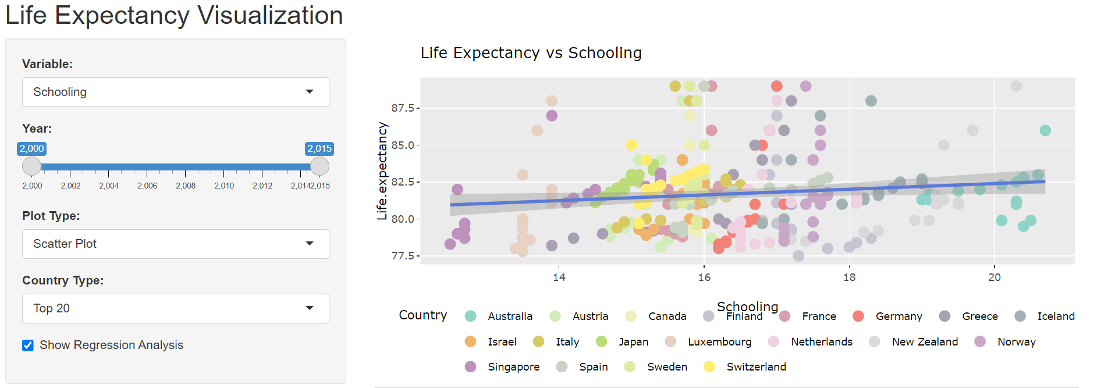
2D Visualizations
Example: Relationship between life expectancy and schooling.
The points represent countries which are colored by their region, hovering on each point shows more information about which country and exact life expectancy average the point has
We can see that average years of schooling are associated with higher life expectancy in the top 20 countries

Slide 6
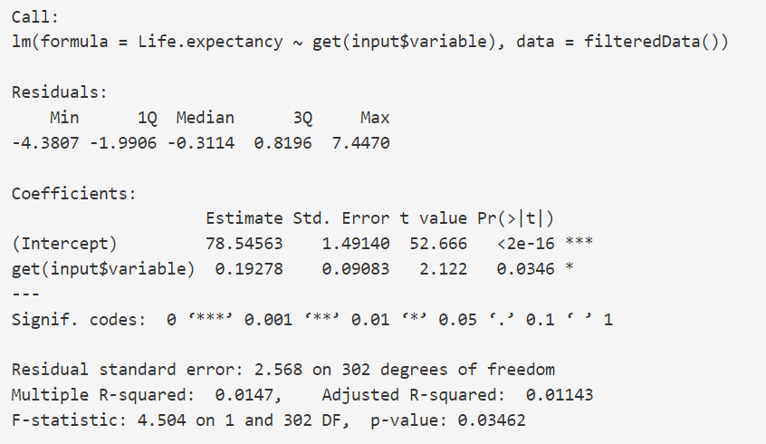
2D Visualizations
Example: Relationship between life expectancy and schooling.
The points represent countries which are colored by their region, hovering on each point shows more information about which country and exact life expectancy average the point has
We can see that average years of schooling are associated with higher life expectancy in the top 20 countries
Less than alpha level 0.05, suggesting significance of estimated effect

Slide 7
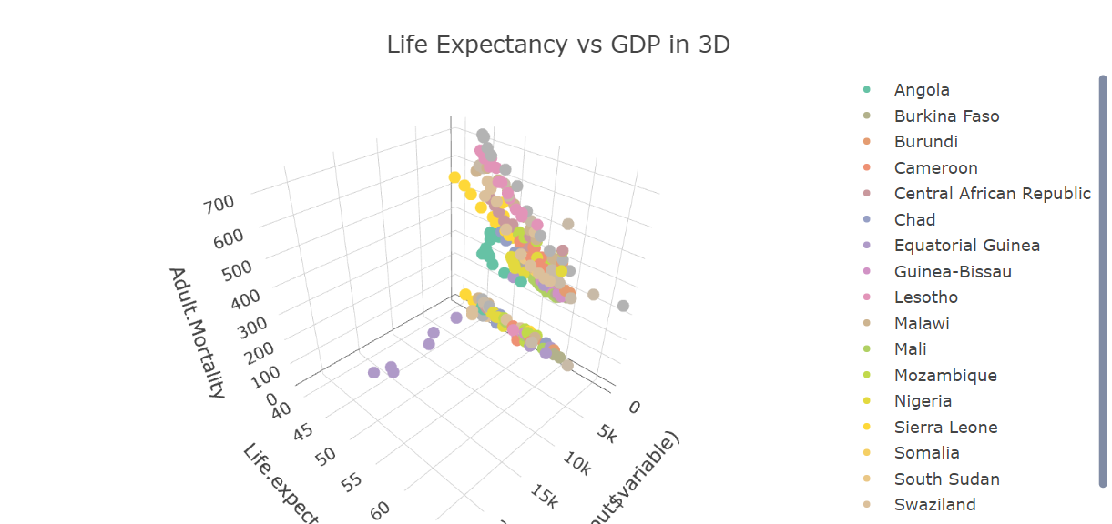
3D Visualization
The 3D Visualization gives a multidimensional view of the data, and allows click-and-drag and zoom in/out exploration to visualize how specific countries change over time, especially when there is a lot of overlap of datapoints in the 2D plot

Slide 8
Insights and Analysis
There is positive correlation between schooling and life expectancy (p-value <0.05)
There is also significant positive impact of GDP on life expectancy (p-value <0.05)
There is negative correlation between adult mortality rate and life expectancy too (expectancy (p-value <0.05)
Average alcohol consumption did not show any significant correlations
This could communicate that GDP and education/years of schooling have significant effect on the average life expectancy in a country.
Further detailed linear regression with all countries at once and more longitudinal data can provide more insights on the variable effects on life expectancy.

Slide 9
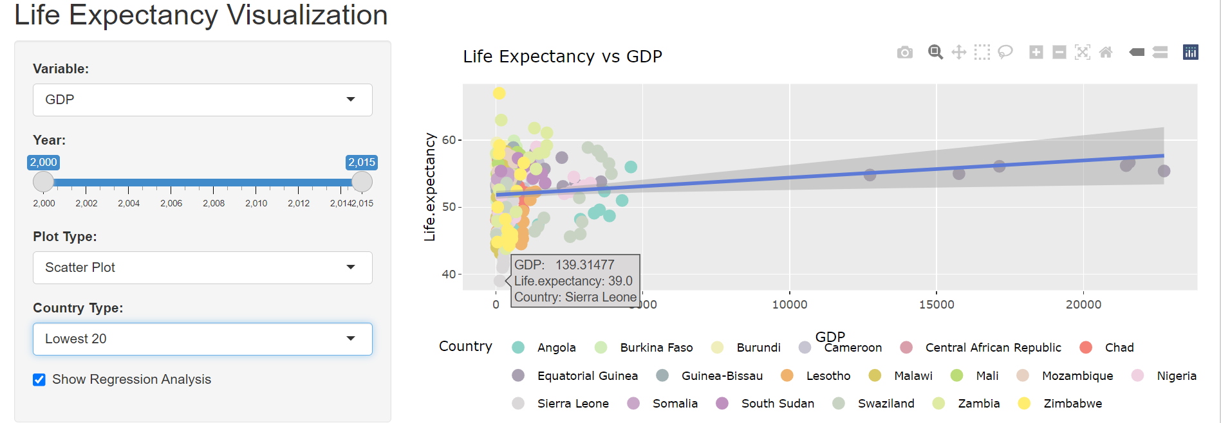
Life Expectancy vs GDP

Slide 10
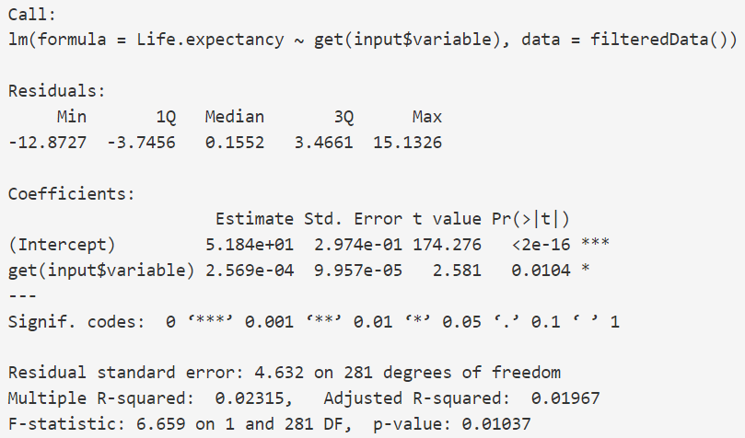
Life Expectancy vs GDP
Less than alpha level 0.05, suggesting significance of estimated effect

Slide 11
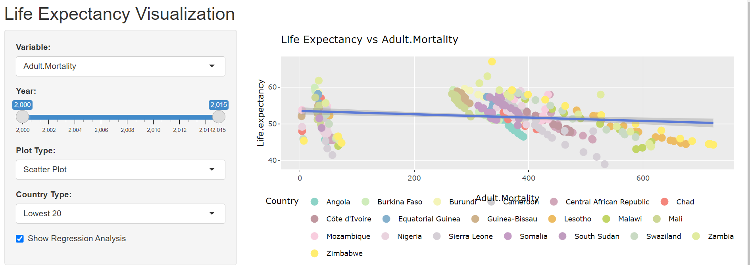
Life Expectancy vs Adult Mortality

Slide 12
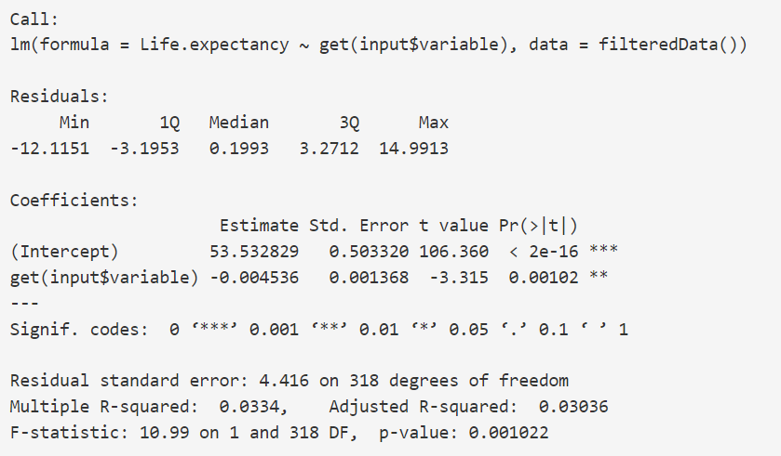
Life Expectancy vs Adult Mortality
Less than alpha level 0.05, suggesting significance of estimated effect

Slide 13
Conclusion
Traditional static 2D analysis methods often lack flexibility. We often need more dynamic exploration, especially in the case of outcomes that have a lot of potentially convoluted relationships between determinants- such as life expectancy
The Life Expectancy visualizer allows for a simple demonstration of interactive exploration of multiple variables in relation to life expectancy
It also allows data to be filtered by year and country within the top 20 and lowest 20 country ranges
The regression analysis allows for quantification of the impact of each variable on life expectancy
Impact: data explorers like this can help inform international health and environmental policies with longitudinal data about factors that could be improving or reducing life expectancy in the long-run

Slide 14
Future Improvements of Visualizer
Include more countries in visualization by splitting dataset into regions/continents, improve statistical power of regression analysis
Include more variables for visualization and regression analysis

Slide 15
Github Repository
https://github.com/vinurao/WHO-Life-Expectancy-Data-Visualizer

